Slide 1
Adventure Escape SA
Presentation by: Charisma & Tyshan

Slide 2
Introduction
This presentation is about the build up project of our POE. It speaks about how we researched, planned and implement our project.
We are going to discuss the core sections of this project which includes all parts

Slide 3

About scenario
Which scenario you may ask ?
For our project we chose the second scenario which is the Adventure escape essay.
Why this scenario ?
After thorough research we realized that there are not many websites and mobile applications for camping places and those which are there do not attract potential customers and are not easy to use.
What makes ours different
This project focuses on designing a user-friendly website and mobile application for Adventure Escape SA.
This platforms will allow users to explore, create an account, view, book and inquire the offerings of Adventure Escape SA.

Slide 4
Members contribution
Tyshan
Did the background research on the project
Coded the mobile application
Created low fidelity wireframes for the mobile application
Created high fidelity wireframes for the mobile application
Charisma
Compiled this presentation
Coded the website
Created high fidelity wireframes for the website
Created the high fidelity wireframes for the website

Slide 5
Chosen logo

Slide 6
Why this logo
We choose this logo because it gave out the idea of what the experience would feel and look like at Adventure Escape SA
Tagline- The logo includes a tagline “Explore- Experience-Escape”
This logo attracts potential customers and sells the idea.

Slide 7
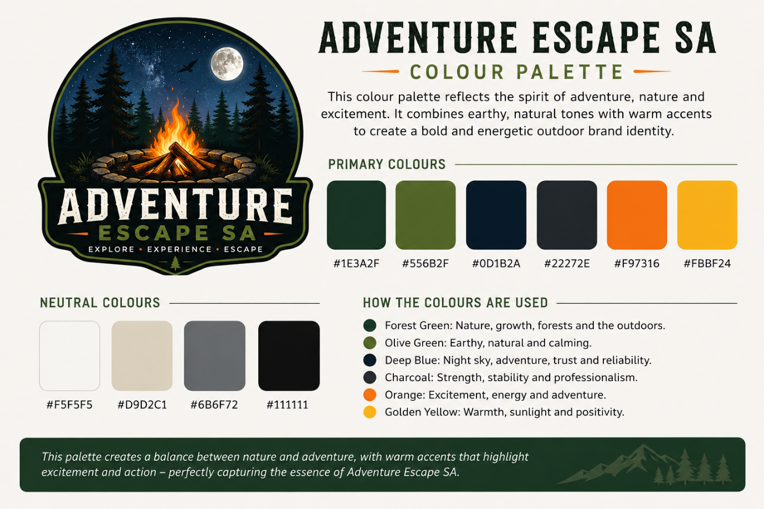
Colour pallete

Slide 8
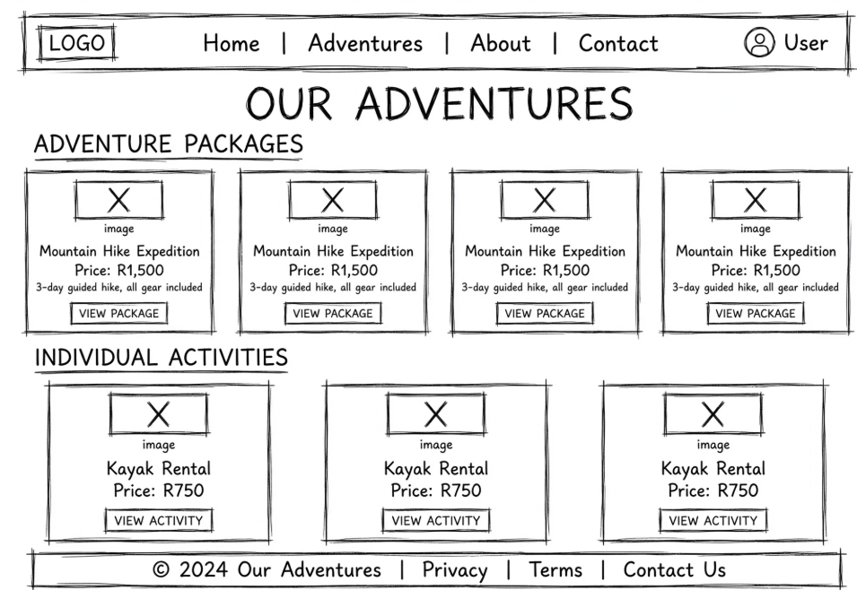
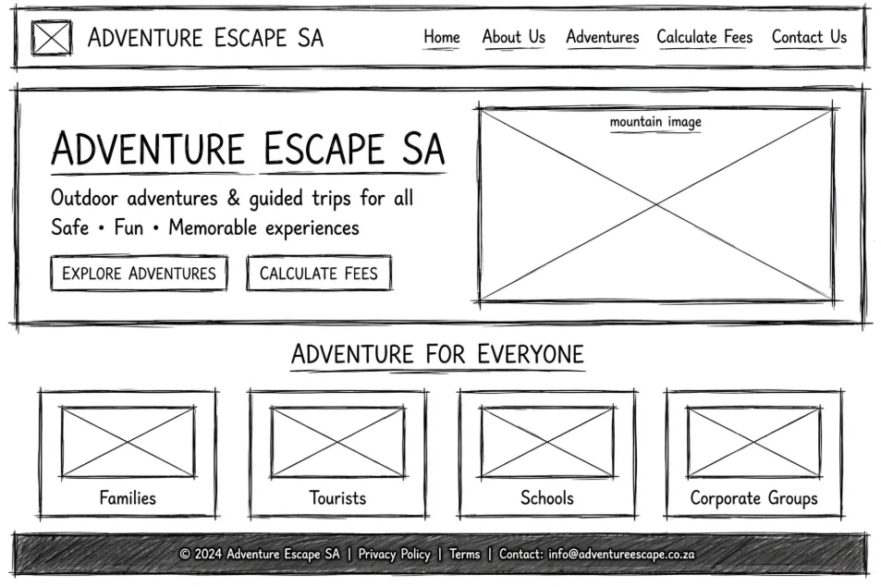
Planning and drafts
low fidelity wireframes
Low fidelity wireframes

Slide 9
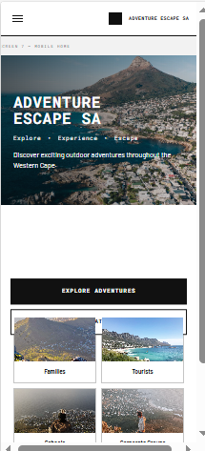
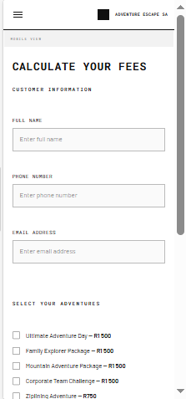
Mobile responsive of the website

Slide 10
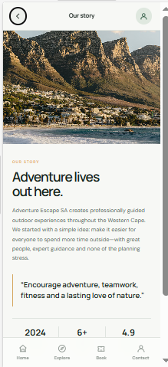
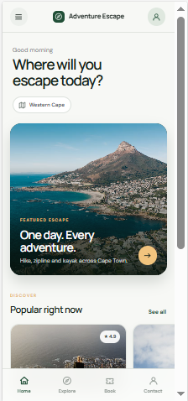
Mobile responsive of application

Slide 11

Encountered issues & Solutions
Syntax errors
Check the code carefully and use the error messages in Visual Studio Code to identify and correct mistakes.
Layout problems
Adjust the styling, spacing, alignment, and layout using React Native components such as View and Text.
Compatibility issues
Test the application on different screen sizes and devices, and use flexible layouts.

Slide 12
Table form
ISSUES | Solutions
Navigation problems | Check the navigation setup and ensure each button is connected to the correct screen.
Application crashes | Check the error messages, fix the code causing the crash, and test the application again.
Choosing a logo, and colour palette | Our choices were made based on that would benefit the company

Slide 13
Conclusion
By: Charisma and Tyshan

